Slide 1
Incremental Unit Testing
STAP Group
Shanghai Jiao Tong University

Slide 2
Agenda
Introduction
Design
Implementation
Evaluation
Demo
Future Work

Slide 3
Agenda
Introduction
Design
Implementation
Evaluation
Demo
Future Work

Slide 4
Introduction
Version 1
Version 2
A small piece of
code change
Test case
Test case
All test cases
Rerun all
test cases?

Slide 5
Introduction
Revision 1
Revision 2
A small piece of
code change
test case
test case
test cases
affected by
the chage
All test cases

Slide 6
Agenda
Introduction
Design
Implementation
Evaluation
Demo
Future Work

Slide 7
Design
Find out all methods affected by change
AST comparison
Find out relationships between test cases and methods
Record the execution trace
Update the relationships when code changes
A database is to track the update

Slide 8
Workflow of the Project
Preprocessing
Incremental testing
Original source
New
source
diff
Diff Result
instrumenting
AffectedTest case
Lookup
Instrumenting
Original source
Database
Rebuild
Execution
log
execute
Test case
Update

Slide 9
Diff
Old source
New source
diff
Diff result
Transform source into canonical form
purge all blank spaces, new lines & comments in each method when performing AST traversal
Compare AST structure and content
Diff result: method added/deleted/modified

Slide 10
Instrumenting
Old source
instrumenting
instrmented
Old source
Instrumenting
Source level or Byte Code level ?
Add logging code in each method
Ensure each method will be exactly invoked once per test case

Slide 11
Source vs Byte Code Level Instrumentation
Byte code level
Pros:
Less time in compilation stage
Cons:
May log too many irrelevant functions at runtime (e.g. intrinsic function)
Optimization must be disabled, program's performance may fell
Compatibility problem, specific version of modified JVM should be used

Slide 12
Source vs Byte Code Level Instrumentation
Source code level
Pros:
Easy to implement
No JVM compatibility issues
Cons:
Increase time in compilation
Change the origin program’s semantic and result in side-effects

Slide 13
Instrumenting
Canonical
old source
instrumenting
Instrmented
old source
Instrumenting
Source level or Byte Code level : JVM’s compatibility is the major concern
Add logging code in each method
Ensure each method will be exactly invoked once per test case

Slide 14
Executing
Database
Instrumented
old source
Execute
update
Test case
Execution path log
Method id | TestCase id
2 | 1
3 | 1
Log execution paths
Parse the log file and find relationship between method id and test case id

Slide 15
Incremental Unit Testing
Diff result
Database
Affected test case
Retrieve affected
test cases
update
Execution path log
Execute
Added: rerun all test cases
Modified: rerun affected test cases
Diff result

Slide 16
Agenda
Introduction
Design
Implementation
Evaluation
Demo
Future Work

Slide 17
Implementation
Gradle based Java Project
Implemented a command-line tool called ‘iut’ and a gradle plugin to support gradle project
Sub-command included in ‘iut’
init/update/inst/gentest/testall/itest
Using sqlite3 as database to save record

Slide 18
Review the Workflow
Preprocessing
Incremental testing
init
Origin source
New
source
diff
Diff result
inst
Instrumenting
diff
AffectedTest case
Lookup
Instrumenting
original source
itest
Execution
log
Database
rebuild
Execute
Test case
Update
gentest
testall
update
iut subcommands

Slide 19
Implementation Status
Basic incremental unit testing tool
Instrumentation source code for logging
Find method level difference between two source folder
Maintain a database to keep track the relationship between test case and method
A simple bash script to support the workflow ,and each single step in this workflow is implemented

Slide 20
Limitations
Only Gradle project with JUnit 4.x is supported
Some Gradle test options are not supported (e.g. include/exclude rules, system environment, etc)

Slide 21
Agenda
Introduction
Design
Implementation
Evaluation
Demo
Future Work

Slide 22
Benchmark
Project | Spring | JsonPath | Gson-xml
colc | 508,167 | 8,170 | 1,737
#testcase | 10056* | 291 | 32**
inst | 19.823 | 1.687 | 0.981
Gradle test | 7’47.38 | 16.264 | 5.972
testall | 8’29.96 | 1.497 | 0.546
Testall.inst | 21’18.37 | 1.921 | 0.680
update | 4:16’6.05 | 45.615 | 5.568
diff | 37.941 | 3.448 | 2.612
* because of the gradle configuration, 11453 test case detect, 10056 test would run
** 33 test cases in origin project but one test case failed

Slide 23
Case Analysis - Spring
We simply modify a constructor in ./spring-aop/src/main/java/org/springframework/aop/aspectj/autoproxy/AspectJPrecedenceComparator.java
It takes 2.972 s to perform `iut diff`
19 test cases are affected
Incrementally testing 19 test cases cost 3.112 s

Slide 24
Case Analysis - Spring
Preprocessing
Incremental testing
Instrumenting
Diff
19.8 s
2.972 s
Testall
Itest
21 min 18 s
+ 540 M logfile
3.112 s
Update
Rerun all
Gradle test
4 hr 16 min
+ 743 M db file
7 min 47 s
Ideally, it will save > 7 minute for a developer to test in this case.
However, the overhead of preprocessing original version is very large.

Slide 25
DEMO

Slide 26
Future Work - Practical
Integrate the IUT tool into real-world development enviroment
Affected test cases can be automatically generated when a change is committed in a version control system
Provide GUI for better use and understanding the work flow of this tool
Notes:
The workflow is pretty complicated as shown in previous slide so command line interface may be difficult to use.

Slide 27
Future Work - Generalized
Support more unit test frameworks (e.g. JUnit 3.x, TestNG) and build systems (e.g. ant)
The following components should be extended to meet the requirements of different system
Test case generator
Test case runner
Support more programming languages
Diff and instrumenting algorithm should be changed

Slide 28
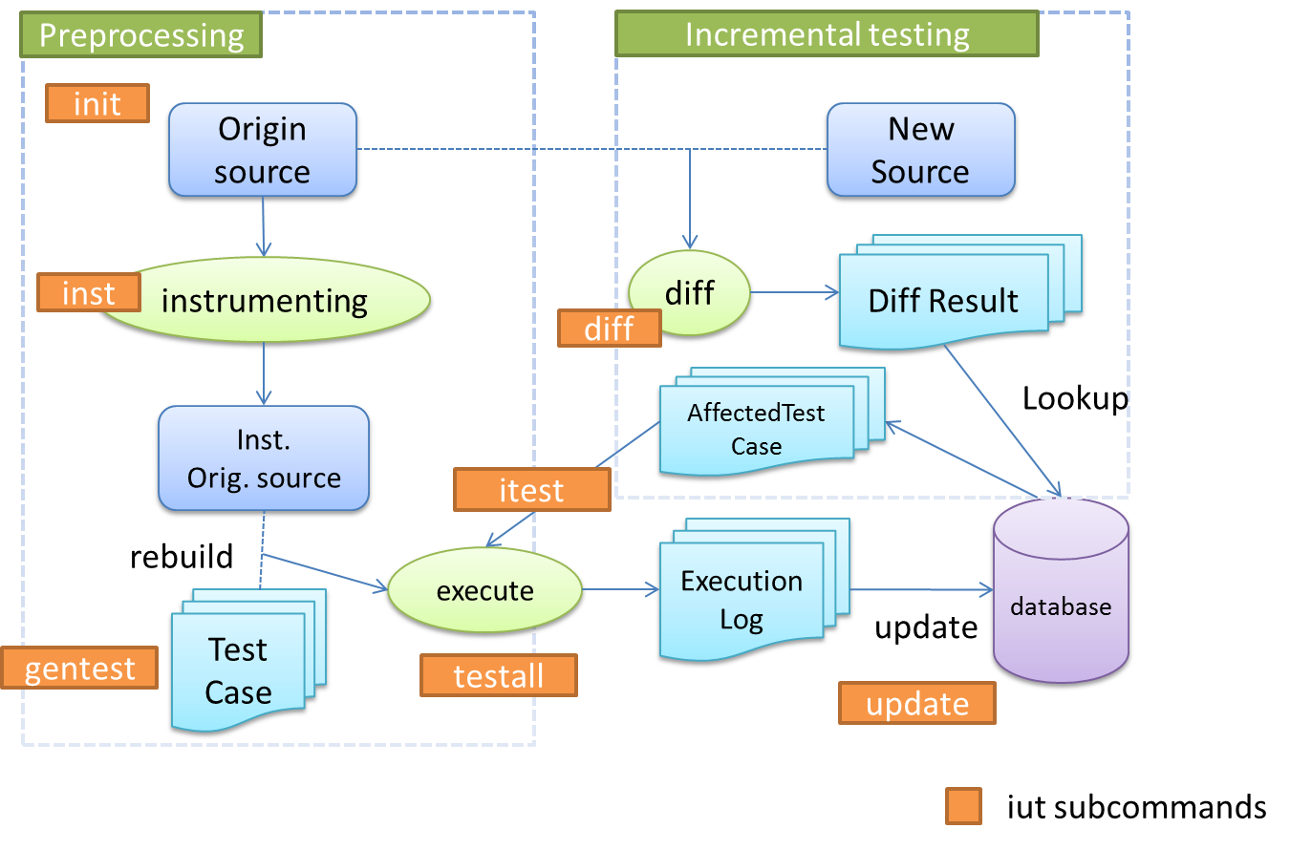

Review the Workflow
Extended components to support varied build/testing system
Extended components to support various programming languages

Slide 29
Future Work – Different Approaches
Using static analysis to find the dependences between test cases and methods
More efficient, less precise
Evaluation on ‘static vs dynamic’

Slide 30
Future Work – Other Issues
External state change
Change of external library
We may not fetch the source code, so we may do bytecode level instrumentation
Change of resource files (e.g. configurations files) of the project
Change of building script of the project
Change of runtime-environment (e.g. OS, different JVM, different locale)

Slide 31
Conclusion
We have implemented a tool to support all basic functionalities of the incremental unit testing
The evaluation result shows that the tool can help the developer to save time in testing if preprocessing of the source codes can be done in advance
The tool has some limitations and further improvements

Slide 32
Thanks to Morgan Stanley for supporting the project!

